Slide 1
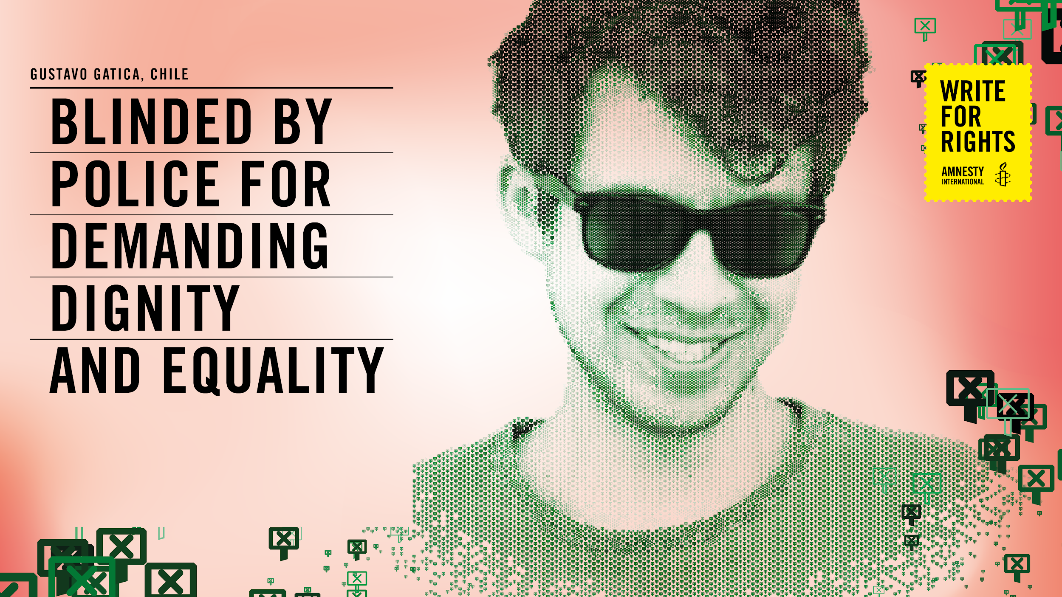
Notes:
The powerpoint presentation needs be used together with the HRE activity of the same name that you can download here https://www.amnesty.org/en/latest/education/2020/10/write-for-rights-human-rights-education-toolkits/
POL 32/2887/2020

Slide 2
IMAGINING AND
SHARING
Close your eyes and imagine what you like doing in your free time.
W4R 2020 ACTIVITY: DEMANDING DIGNITY AND EQUALITY
2
Notes:
Welcome participants by asking them to close their eyes and think about their hobbies. Be clear that they should imagine this with their eyes closed.
Read the following paragraph aloud
What do you like to do in your free time? Do you like to play sports, play an instrument, read a book, watch movies? Visualize yourself engaging with your hobbies – what are you doing? Who are you with? Which body parts are you using? How are they moving? What do you see, how do you feel? Continue by reading out the following: You have your eyes closed now. What if you couldn’t use your eyes anymore? Would you still be able to fully participate in your hobby? Would there be any obstacles? How do you feel now? What would you miss?
Ask them to keep their eyes closed, and tell them the following story:
“Gustavo, a 22-year-old psychology student from Chile, loves photography and playing music. He is learning how to play the guitar and the piano. Gustavo tragically lost his eyesight last year and can no longer practise his hobbies. He says about the incident: ‘I gave my eyes so that people would wake up’.”
Ask participants to open their eyes and tell them that they will come back to what Gustavo wanted the world to wake up to later. You can ask them to do a quick shake off to bring their attention back to the present moment, their surroundings and the session.
Tell participants to keep their eyes closed as your read the prompts from pg 6, 7 from the HRE Activity. downloaded If any participants of the group are visually impaired you can ask them to reflect on something that they would like to share about their own experience to help participants understand their reality.

Slide 3
GUSTAVO’S
STORY
How did you feel?
What did you discover with the exercise?
What would you miss the most?
W4R 2020 ACTIVITY: DEMANDING DIGNITY AND EQUALITY
3
Notes:
Ask participants How they felt. They can write the key words in the chat or can write the words and show them, they can say and you can write the words.
Optional you can send a Link to word cloud (https://www.mentimeter.com/)
Ask participants what they discovered during the activity. Ask them what they would miss if they could no longer use their eyes, collecting responses from different participants.

Slide 4
GUSTAVO’S
STORY
What causes do you feel strongly about? Why?
What have you done about them?
Have you ever demonstrated on the streets for any cause? Why/why not?
Whose responsibility do you think it is to protect people’s safety when they are demonstrating?
W4R 2020 ACTIVITY: DEMANDING DIGNITY AND EQUALITY
4
Notes:
Explain to participants that they will now be reflecting on something completely different: things in their life that they feel strongly about or have felt strongly about in the past. Ask them to explain why? Ask them to write what they have done about them. Explain them (this could be anything from learning or reading about it, speaking about it, taking an action for it or other things)?

Slide 5
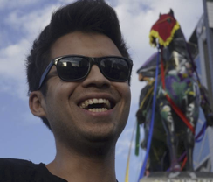
GUSTAVO’S
STORY
When in 2019 protests broke out across Chile over rising prices and inequality, Gustavo Gatica was studying psychology in the capital, Santiago. Like millions of others, he also took the streets. Demonstrations lasted for months, capturing imaginations around the world.
This was people power in action and it was awe-inspiring. The authorities, however, took a different view. At one fateful protest in November, police loaded their shotguns with rubber and metal ammunition and fired into the gathered crowds. It was no different from other protests where hundreds were hurt and dozens suffered eye injuries almost every day.
Those in charge didn’t stop the police officers. Instead, they allowed the violence to continue. Gustavo was among the crowds that November. He was shot in both eyes and permanently blinded.
The attack made global headlines. An initial internal police investigation following the shooting found that no one could be held responsible, and it even suggested that demonstrators themselves injured Gustavo. However, after public criticism about this outcome, the investigation was reopened and is currently pending. The National Prosecutor’s Office is now investigating.
Still, those who allowed the attack on Gustavo remain unpunished. As demonstrations continued, protesters wore eye patches and chanted his name at police.
They want justice, truth and reparation. So do we.
W4R 2020 ACTIVITY: DEMANDING DIGNITY AND EQUALITY
5
Notes:
Read out Gustavo’s story

Slide 6
GUSTAVO’S
STORY
What surprises you most about Gustavo’s story?
How has his life changed as a result of attending the protest?
Why were people on the street demonstrating?
W4R 2020 ACTIVITY: DEMANDING DIGNITY AND EQUALITY
6
Notes:
Reflect with participants on the questions

Slide 7
GUSTAVO’S
STORY
What is the role of police in demonstrations?
What do you think happened to the police who fired shots? Is it enough to suspend the police officers involved?
What do you think should happen to the commanders in charge of the police on duty?
W4R 2020 ACTIVITY: DEMANDING DIGNITY AND EQUALITY
7

Slide 8
GUSTAVO’S
STORY
What do you think is needed to break the cycle of police violence?
W4R 2020 ACTIVITY: DEMANDING DIGNITY AND EQUALITY
8

Slide 9
USE OF FORCE AND
HUMAN RIGHTS
The use of force must be necessary: it must be the lowest level of force needed to achieve a legitimate objective
The force must be proportionate to the risk or the danger (for example, you cannot shoot someone for jaywalking)
Where use of force by the police has resulted in injury or death, a prompt, thorough, independent and impartial investigation must be carried out by civilian authorities
W4R 2020 ACTIVITY: DEMANDING DIGNITY AND EQUALITY
9
Notes:
Explain that Police officers are allowed to do things that normal citizens cannot – for example, use force to arrest someone, detain someone in a prison cell, carry weapons. The police are given these additional powers so that they can carry out their responsibility to protect citizens and keep public order. However, with power comes responsibility: the police are permitted to use force against others, but they must always do so in accordance with human rights law. This slide and the next explain the relation of use of force and human rights

Slide 10
USE OF FORCE AND
HUMAN RIGHTS
Police officers must be held accountable if they misuse their powers and they must face due process of law
Law enforcement agencies must create an operational framework with clear instructions for what to do in situations that officers may face during their work, including decisions about whether the use of force is appropriate.
W4R 2020 ACTIVITY: DEMANDING DIGNITY AND EQUALITY
10
Notes:
Explain that Police officers are allowed to do things that normal citizens cannot – for example, use force to arrest someone, detain someone in a prison cell, carry weapons. The police are given these additional powers so that they can carry out their responsibility to protect citizens and keep public order. However, with power comes responsibility: the police are permitted to use force against others, but they must always do so in accordance with human rights law. This slide and the next explain the relation of use of force and human rights

Slide 11
INTERNATIONAL GUIDELINES
Were the following international guidelines upheld in Gustavo's case?
It is the role of police to facilitate peaceful protests. If tensions arise, the police have a duty to de-escalate them.
If some protesters engage in violent actions, this does not turn the otherwise peaceful protest into a non-peaceful assembly. Police should ensure those who remain peaceful can continue protesting
Acts of violence by a small minority do not justify indiscriminate use of force J If use of force is unavoidable to secure the safety of others, police must use the minimum force necessary
W4R 2020 ACTIVITY: DEMANDING DIGNITY AND EQUALITY
11
Notes:
Were the following international guidelines upheld in Gustavo's case? Read out each point and ask participants to vote with 'yes’ or ‘No’ in the chat or if you see participants they can use thumbs up or thumbs down.

Slide 12
INTERNATIONAL GUIDELINES
Were the following international guidelines upheld in Gustavo's case?
The decision to disperse a protest must be a last resort – when all other less restrictive means have proven to be unsuccessful
Tear gas or water cannons to disperse a protest should only be used if people can leave the scene. They may only be used in response to widespread violence and where more targeted means have failed to contain the violence
Firearms should NEVER be used to disperse a crowd
W4R 2020 ACTIVITY: DEMANDING DIGNITY AND EQUALITY
12
Notes:
Were the following international guidelines upheld in Gustavo's case? Read out each point and ask participants to vote with 'yes’ or ‘No’ in the chat or if you see participants they can use thumbs up or thumbs down

Slide 13
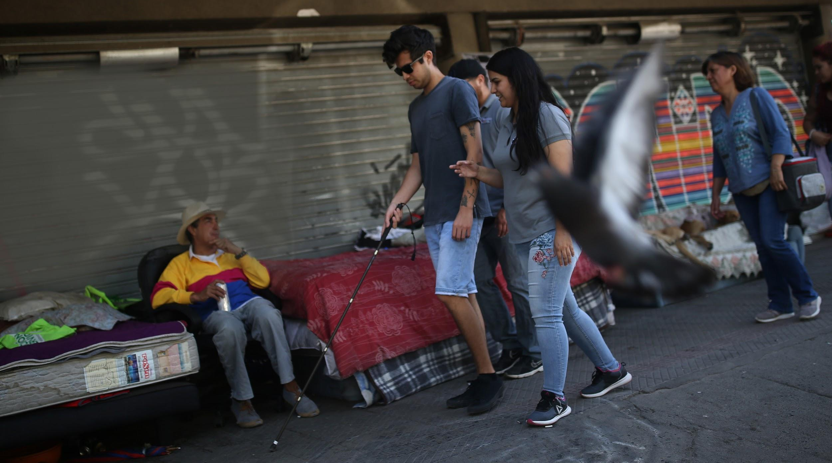
USE OF FORCE AND
HUMAN RIGHTS
Do you think Chilean Police followed International Guidelines during the demonstration Gustavo participated in?
W4R 2020 ACTIVITY: DEMANDING DIGNITY AND EQUALITY
13
Notes:
You can conclude with the question Do you think Chilean Police follow International Guidelines during the demonstration Gustavo participated in?

Slide 14
GUSTAVO’S
STORY
Has Gustavo’s right to peaceful assembly been respected?
Do you know of other protests where tactical police violence has been used to stop people accessing their rights?
What can be done to help Gustavo achieve justice?
W4R 2020 ACTIVITY: DEMANDING DIGNITY AND EQUALITY
14
Notes:
Depending on time you can continue the discussion with these questions

Slide 15
REFLECTION
“The intention of the Chilean security forces is clear: to injure demonstrators in order to discourage protest, even to the extent of using torture and sexual violence against protesters. (...) Guaranteeing justice and non-repetition of these incidents must involve sanctions against those superiors who, in the full knowledge of the crimes committed by officials under their command, have ordered or tolerated them day after day.”
Erika Guevara-Rosas, Americas director at Amnesty International
W4R 2020 ACTIVITY: DEMANDING DIGNITY AND EQUALITY
15
Notes:
With this quote in mind, circle back to the earlier question and conclusions , asking whether it is enough to suspend police officers if their superiors willingly condoned the violence and allowed for it to continue in this and in other protests.

Slide 16

HOW DOES WRITE FOR RIGHTS WORK?
WHY DO WE NEED
TO TAKE ACTION?
In country after country, people’s freedom to speak out against injustice, to live on their ancestral lands, to not be discriminated against – is under threat.
Our letters, words and actions will put pressure on authorities to take immediate ​ action, so that those who abuse will be brought to justice. And those unjustly imprisoned will taste freedom ​once again.
People in more than 170 countries and territories take part in all kinds of events
Writing millions of letters, emails, tweets and petitions
Supporting people who’ve been harassed, threatened and unjustly jailed
Putting pressure on governments, leaders and decision-makers
Showing love and support for the people and their families
And making change happen – releasing activists, securing justice for those whose rights have been wronged and protecting people who stand up for change
W4R 2020 ACTIVITY: DEMANDING DIGNITY AND EQUALITY
16
Notes:
Explain to participants about the Write to Right Campaign that Amnesty runs each year using the slide. Explain that this year Amnesty is calling on people around the world to take action on behalf of Gustavo. If you have time you could share the link of the video in the chat for participants to watch
https://www.youtube.com/watch?v=akYn8sBON3E&list=PLYFf1wOwAZJBBjjzu6LgpEtR3aeiCqrj6&index=2

Slide 17
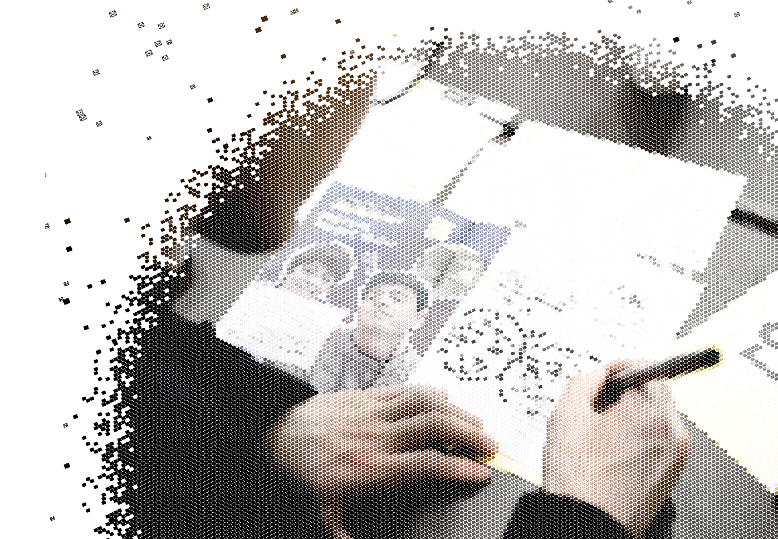
HOW TO WRITE
FOR RIGHTS
1. LISTEN TO THE STORIES
2. WRITE YOUR LETTERS TO:
The government we are trying to persuade to help the person or people featured in each case
The person or people we want to help, or someone they are close to
3. TAG YOUR LETTERS SO AMNESTY CAN FIND ​THEM ON SOCIAL
Take a photo of your letter
Post in on your social media channels, tagging it with the unique event hashtag
Make sure the posts are public so we can find it
4. AMNESTY WILL DELIVER YOUR LETTERS
Amnesty will then collect all actions and give them to the governments, the people we’re trying to help, or their families
W4R 2020 ACTIVITY: DEMANDING DIGNITY AND EQUALITY
17
Notes:
Explain how to write for rights using the slide. Explain that Amnesty is encouraging people to write letters to the authorities and show solidarity for Gustavo

Slide 18
WRITE A LETTER,
CHANGE A LIFE
Encourage them to write to Chile’s National Prosecutor at the following address:
Jorge Abbott Charme Fiscalía Nacional,
Catedral 1421-1453 Santiago de Chile, Chile
Email: jabbott@minpublico.cl(cc aseguel@minpublico.cl)
Twitter: @FiscaliadeChile
Facebook:https://www.facebook.com/pages/Fiscal%C3%ADa%20Nacional/345649492241585/
Instagram: @fiscaliadechile
Salutation: Dear National Prosecutor, Jorge Abbott Charme
You can use the template letters in the letter writing toolkit which you can download on the Write for Rights web page at www.amnesty.org/writeforrights
Or use the following guidelines to write a more personal letter:
Tell him something about yourself
Tell him what shocks you about the case
Tell him to investigate the commanders involved in Gustavo’s shooting. They had a duty to avoid the misuse of dangerous shotguns and ammunition, but they failed to fulfil it.
W4R 2020 ACTIVITY: DEMANDING DIGNITY AND EQUALITY
18
Notes:
If there isn’t enough time for participants to take action by writing letters.
Participants can also take action online. Share the link https://www.amnesty.org/en/get-involved/write-for-rights/ in the chat.
Tip: You could play some music for the group while they complete this activity
You can use the song written for Gustavo Access to youtube to play Nano Stern’s song https://www.youtube.com/ watch?v=xRcsUDbUKwo

Slide 19
HOW CAN CHANGE
HAPPEN
Encourage participants to send messages of hope and solidarity to Gustavo to tell him his loss is not in vain. Be mindful that solidarity actions should be accessible for Gustavo who can no longer see. Participants could send him recordings of their messages of hope and solidarity.
For example, audio notes, songs, poems, embroidery or physical braille letters, including your name and where you are from saying the following:
“Mucha fuerza Gustavo. La lucha sigue y tu esfuerzo no ha sido en vano” (Stay strong, Gustavo. The fight goes on and your effort has not been in vain)
“Gustavo! tu historia me ha inspirado y es un ejemplo de valentía en la defensa por el derecho a la protesta” (Gustavo! Your story has inspired me and is an example of courage in defending the right to protest)
W4R 2020 ACTIVITY: DEMANDING DIGNITY AND EQUALITY
19
Notes:
You could play nice music and have people holding their message or singing together and you can take a screenshot of the screen and a joint solidarity photo or recording for Gustavo..Share on social media with #W4R20

Slide 20
HOW CAN CHANGE
HAPPEN
For social media you can use the following Hashtags:
#InvestiguenMandos #ChileDespertó #ChileDespertó y elmundofue testigo.
Por #GustavoGatica y cientos más, ahora es el momento de que @FiscaliadeChile investigue a los mandos responsables. #InvestiguenMandos // Chile woke up and the world bore witness. Now is the time for @FiscaliadeChile to investigate commanders in charge. #ChileDespertó
@FiscaliadeChile, commanders are responsible for allowing eye mutilation of #GustavoGatica and hundreds of others. #InvestiguenMandos J@FiscaliadeChile investiguen a los mandos de @Carabdechile porque queremos un Chile con justicia y sin impunidad. #InvestiguenMandos
Send physical braille letters, or any physical show of solidarity to Chile’s Amnesty International Section:
Amnistía Internacional Chile
Calle Eliodoro Yañez 828
Comuna de Providencia
Santiago de Chile
And digital copies of the letters to Gustavo at justiciaparagustavo@amnistia.cl
W4R 2020 ACTIVITY: DEMANDING DIGNITY AND EQUALITY
20

